Slide 1
An Analysis on Clustering based on the Kruskal’s Algorithm
Presented by Xiaobo Qian, Yangli Liu, Lu Wang, Jieqi Yang
4/29/2022

Slide 2
Agendac
Project introduction
The clustering approach based on Kruskal’s algorithm
The K-means clustering
The improvements to Kruskal’s algorithm clustering
Conclusion

Slide 3
Agendac
Project introduction
The clustering approach based on Kruskal’s algorithm
The K-means clustering
The improvements to Kruskal’s algorithm clustering
Conclusion

Slide 4
Project Background
Clustering is one of the major data analysis tools in the field of data mining and it is also a Machine Learning technique。
In practice, clustering helps identify the meaningfulness of data. (e.g. gene expression; customer segmentation)
5.8 fertility

Slide 5

Different Clustering Algorithms
Offer different approaches to the challenge of discovering natural groups in data
Kruskal’s
K-Means
Have limitations in meeting their robustness and quality for clustering
OPTICS
BIRCH

Slide 6
Project Purposes
Offer Offer different approaches to the challenge of discovering natural groups in data
approaches to the challenge of discovering natural groups in ddifferent approaches to the challenge of discovering natural groups in data
How we explore:
How the two algorithms work?
Performance evaluation
Improvement
Kruskal's algorithm clustering
K-means clustering

Slide 7
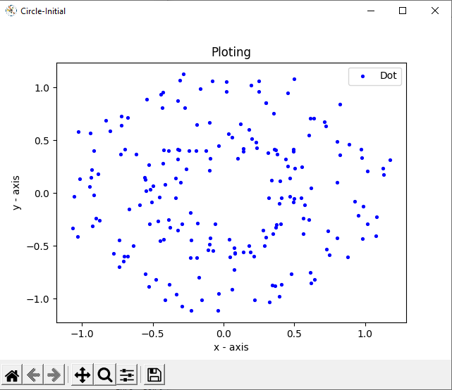
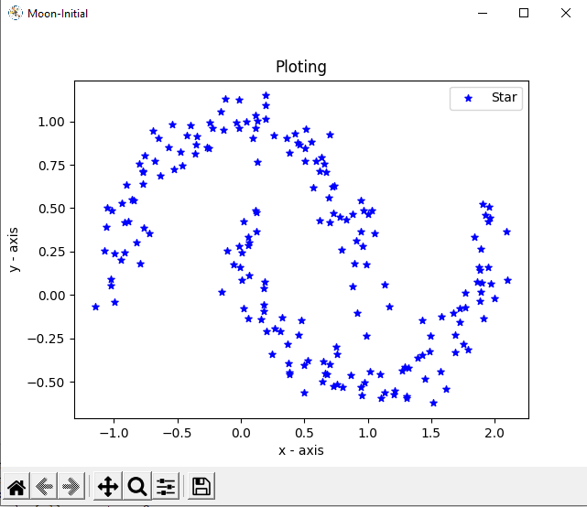
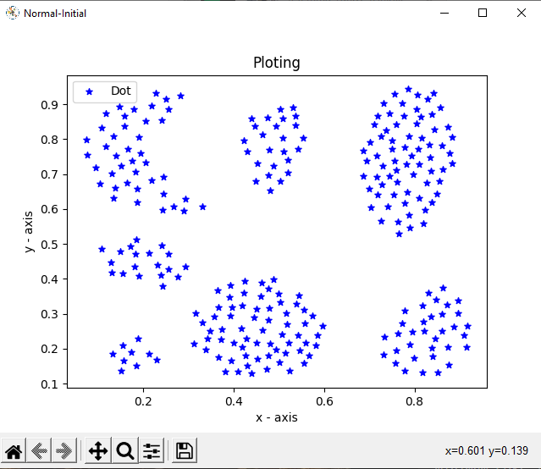
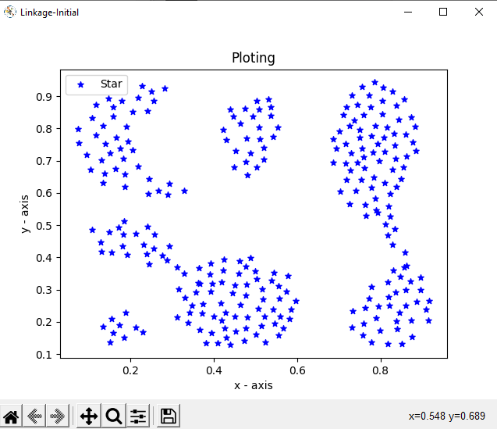
Dataset

Slide 8
Agendac
Project introduction
The clustering approach based on Kruskal’s algorithm
The K-means clustering
The improvements to Kruskal’s algorithm clustering
Conclusion

Slide 9
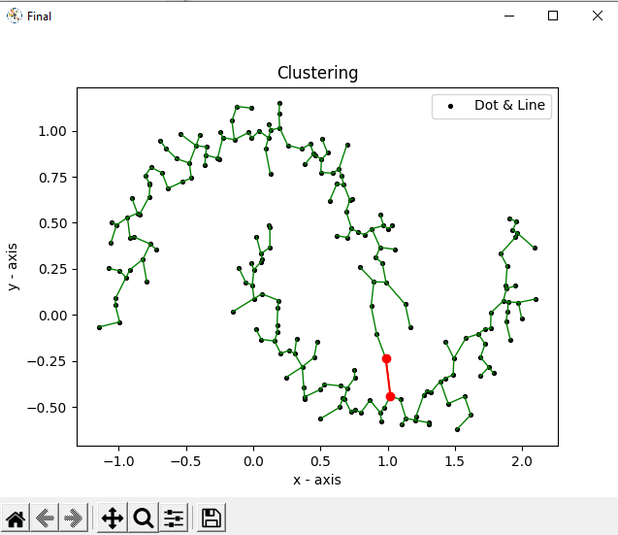
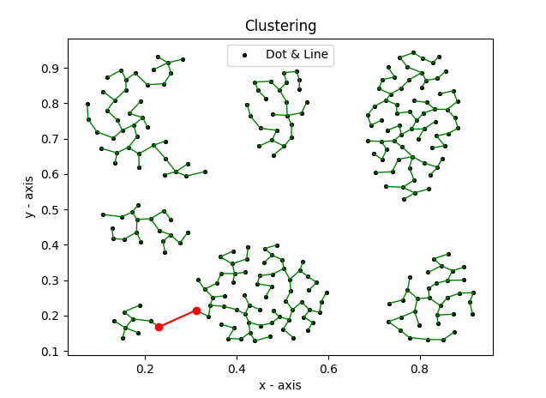
Kruskal’s Algorithm
We have adapted what we learned from Kruskal’s algorithm into K-clustering algorithm. Each data point in K-clustering algorithm is a node with properties of parent and rank, and each node is a single cluster at the beginning. We maintain clusters as a set of connected components of a graph. After iteratively combining the clusters containing the two closest nodes by adding an edge between them, we will be able to draw the clusters in a forest-like way. The algorithm will stop when there are k clusters that k numbers are pre-selected by us. It will return the actual decimal numbers of the spacing of the clustering.
Notes:
When it comes to the technical details of Kruskal’s algorithm, we need to sort all the edges in non-decreasing order based on their weights. The straightforward way is to create an empty set T and then add the edge from the sorted edge array into T as long as it does not form a cycle with edges that are already in the set. In order to speed up the process of checking the cycle's existence, we need to create a data structure called Union-Find. This structure is also called merge-find as it stores a collection of non-overlapping sets. In the actual implementation, we see that Find(group, x) operation tells if value x has the same parent of the group, and Union(group1, group2) function makes a union set from the two individual sets group1 and group2. After setting the useful utility function Find and Union, we can move on to pick the smallest edge and increment the index for the next iteration. If the Find function tells us that including this edge does not cause a cycle, we include it in the result array and increment the index of the result array by one. Otherwise, we discard the edge.

Slide 10
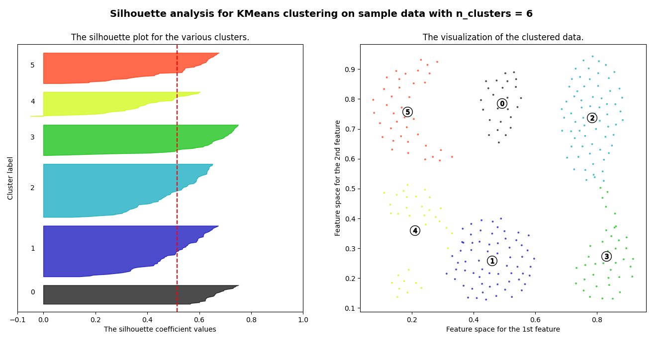
Picking K
We did not mention this in our final report but we have tried different methods to find an optimal clusters numbers(value of k) for our K-clustering, like Elbow Method and Silhouette Method. Elbow Method is an empirical method to pick the value of k, where the average distance falls suddenly.
Notes:
Silhouette method computes silhouette coefficients of each point and average it out for all the samples to get the silhouette score. This measure how much a point is similar to its own cluster compared to other clusters. Using this method, we got some ideas about how k value effects our clustering result.

Slide 11
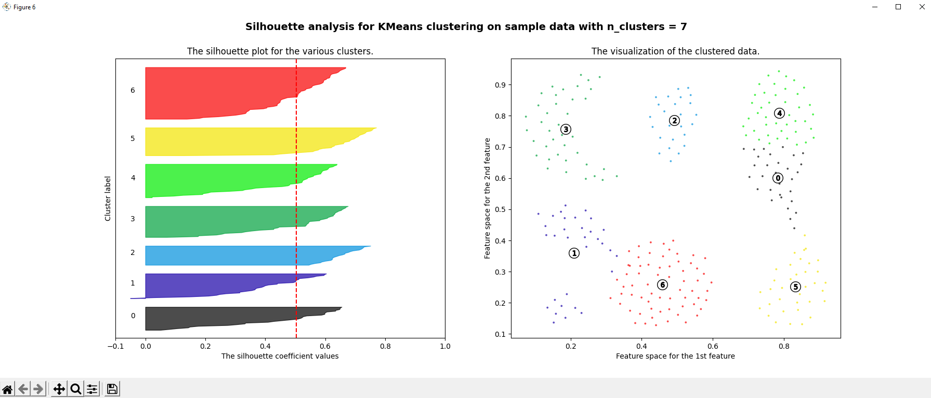

Silhouette Method
Silhouette method computes silhouette coefficients of each point and average it out for all the samples to get the silhouette score. This measure how much a point is similar to its own cluster compared to other clusters.
Notes:
Using this method and the formula, we got some insights about how k value effects our clustering result. Unfortunately, this method is pretty good at finding optimal k for some special cases but the result sometimes is not very ideal as we want to have 7 clusters for our sample dataset. And it also uses k-means prebuilt library which cannot be counted as our effort to improve kruskal's based clustering algorithm.

Slide 12
Agendac
Project introduction
The clustering approach based on Kruskal’s algorithm
The K-means clustering
The improvements to Kruskal’s algorithm clustering
Conclusion

Slide 13
K-Means
K-means is an introductory algorithm to clustering techniques and it is widely used in unsupervised learning problems. K represents the number of clusters we are going to classify our data points into.

Slide 14
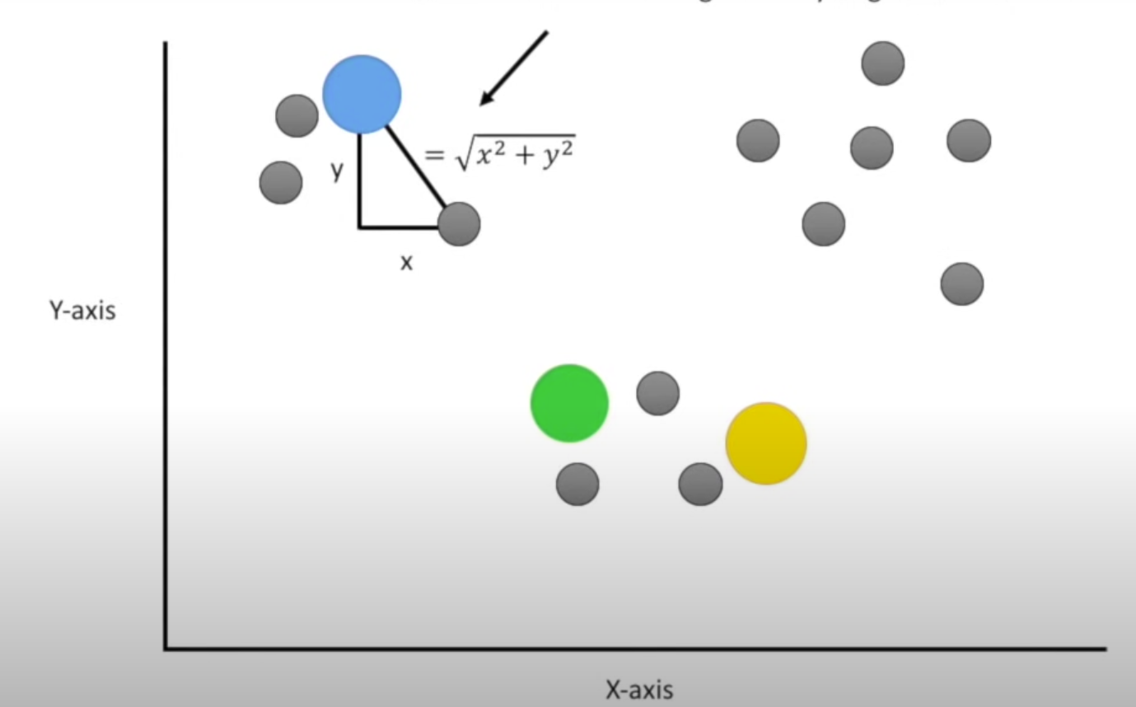
How does K-means work
K-means clustering repeatedly calculates and finds K centroids and group points with their nearest centroid.
The algorithm will stop when:
Complete the maximum number of iterations;
New formed centroids don’t change any more
Clusters don’t change any more.
Image source:
https://www.youtube.com/watch?v=4b5d3muPQmA

Slide 15
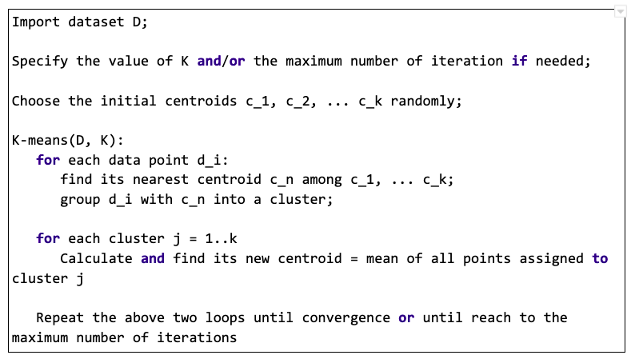
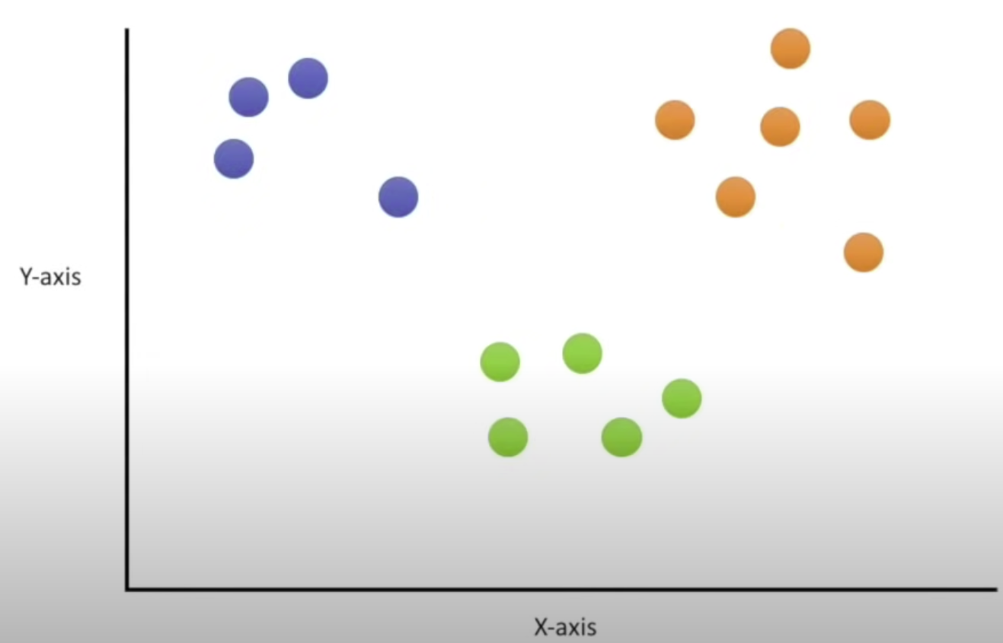
K-means pseudocode
Initialization
Repeatedly find centroids
Image source:
https://www.youtube.com/watch?v=4b5d3muPQmA

Slide 16
Performance Evaluation
Kruskal
K-means
No need to iterate multiple times
Clusters are clearly separated
Multiple times of iteration to find the centroids of the clusters
Clusters were interspersed

Slide 17
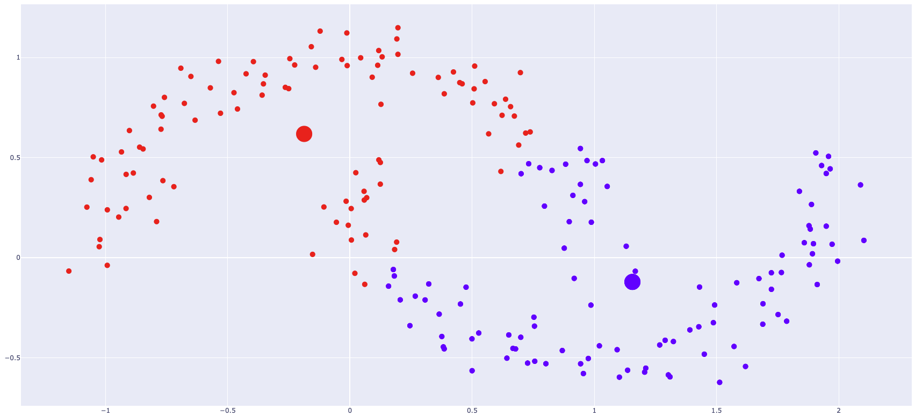
Performance Evaluation
Two-moons by Kruskal
Two-moons by K-means

Slide 18
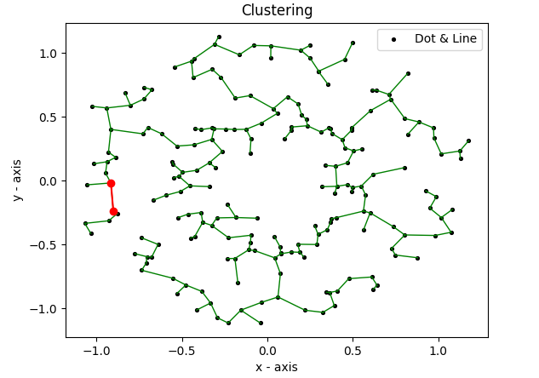
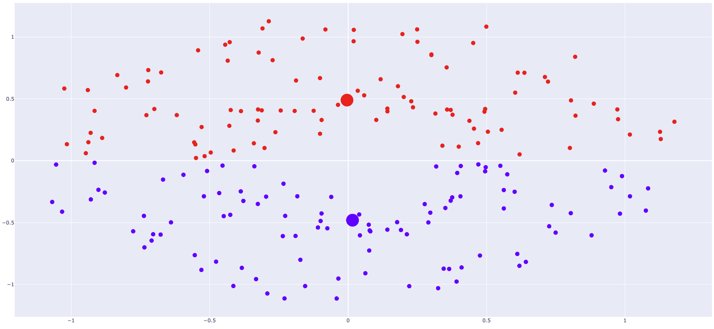
Performance Evaluation
Two-circles by Kruskal
Two-circles by K-means

Slide 19
Agendac
Project introduction
The clustering approach based on Kruskal’s algorithm
The K-means clustering
The improvements to Kruskal’s algorithm clustering
Conclusion

Slide 20
Improvement
Improvements based on distance
Chebyshev distance is a metric defined on a vector space where the distance between two vectors is the greatest of their differences along any coordinate
dimension.
Manhattan distance is a distance metric between two points in a N dimensional vector space. It is the sum of the lengths of the projections of the line segment between the points onto the coordinate axes.
Notes:
Manhattan distance captures the same by aggregating the pairwise absolute difference between each variable; Chebyshev distance calculates the maximum of the absolute differences between the features of a pair of data points; Mahalanobis distance is a multi-dimensional generalization of the idea of measuring how many standard deviations away of a point is from the mean of the distribution.

Slide 21
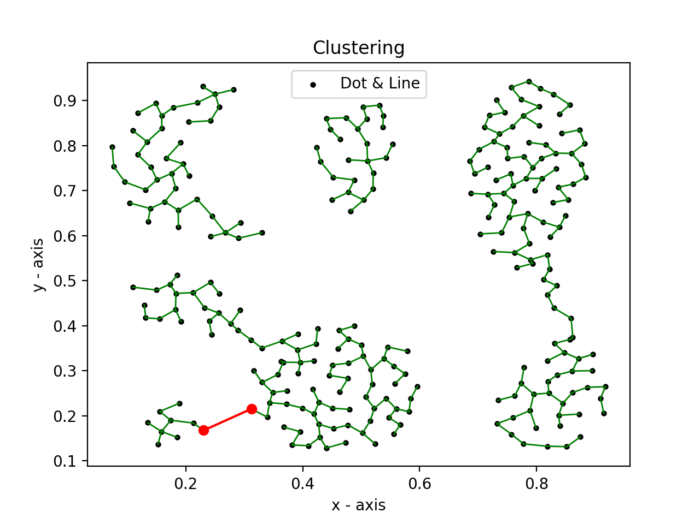

Improvement
Improvements based on distance
Mahalanobis distance is a measure of the distance between a point P and a distribution D. It is a multi-dimensional generalization of the idea of measuring how many standard deviations away P is from the mean of D.
Kruskal clustering based on Mahalanobis distance
Notes:
Unfortunately, there is no evident improvement on segmenting our datasets and we still cannot achieve a desired result by using different distance formulas.

Slide 22
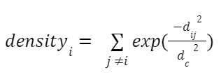
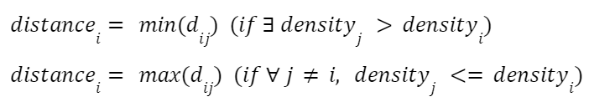

Improvement
Improvements based on density
CFSFDP(Clustering by fast search and find of density peaks) is one way of finding “density peaks”. They can be deem as cluster centers.

Slide 23
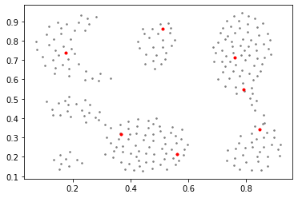
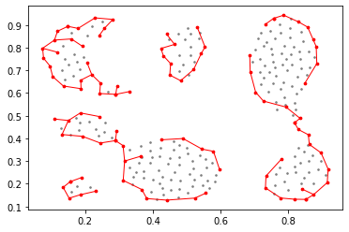
Improvement
Improvements based on density
CFSFDP(Clustering by fast search and find of density peaks) is one way of finding “density peaks”. They can be deem as cluster centers
“Imperfect Density Peaks” by naive CFSFDP
“Perfect Borders and Links” detection by naive CFSFDP

Slide 24
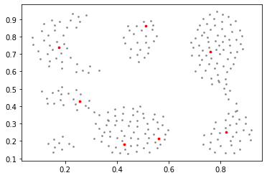
Improvement
Improvements based on density
CFSFDP(Clustering by fast search and find of density peaks)
Fixing center positions of CFSFDP by elimination of low density vertices can help us evaluate the clustering results of Kruskal clustering.
“Imperfect Density Peaks” by naive CFSFDP
“Fixed Centers” by elimination of vertices

Slide 25
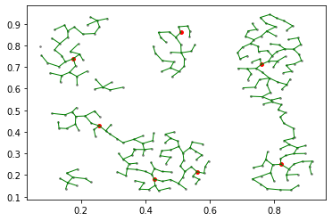
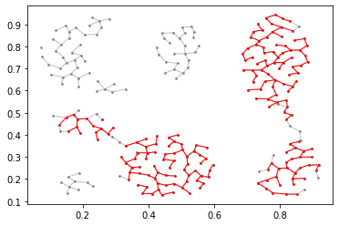
Improvement
Improvements based on density
CFSFDP(Clustering by fast search and find of density peaks)
Clusters would be divided again if it contains more than 1 centers. Some vertices can be eliminated during the process.
Original Kruskal Clusters and “CFSFDP Centers”
Kruskal Clustering Improved by CFSFDP

Slide 26
Agendac
Project introduction
The clustering approach based on Kruskal’s algorithm
The K-means clustering
The improvements to Kruskal’s algorithm clustering
Conclusion

Slide 27
Conclusions
Kruskal’s clustering
Comparison with K-means clustering
Improvements to the Kruskal’s clustering

Slide 28
References
Wang Peng, Wang Junyi, "A Clustering Algorithm Based on Find Density Peaks," Proceedings of 2017 the 7th International Workshop on Computer Science and Engineering, pp. 81-85, Beijing, 25-27 June, 2017.
A. Rodriguez and A. Laio,”Clustering by fast search and find of density peaks,”Science,vol.344,pp.1492-1496,June.2014.
P. K. Jana and A. Naik, "An efficient minimum spanning tree based clustering algorithm," 2009 Proceeding of International Conference on Methods and Models in Computer Science (ICM2CS), 2009, pp. 1-5, doi: 10.1109/ICM2CS.2009.5397966.
https://medium.com/@mitanshupbhoot/comparative-applications-of-prims-and-kruskal-s-algorithm-in-real-life-scenarios-4aa0f92c7abc
https://sites.google.com/site/dataclusteringalgorithms/clustering-algorithm-applications?authuser=0
https://ieeexplore.ieee.org/stamp/stamp.jsp?tp=&arnumber=5397966
https://www.researchgate.net/publication/11355740_Clustering_gene_expression_data_using_a_graph-theoretic_approach_An_application_of_minimum_spanning_trees
https://docs.google.com/document/d/1wWkZLMgSnQsENh8NjrpcR-pdkRelwFr6SiuC31H48W4/edit#
https://www.geeksforgeeks.org/k-means-clustering-introduction/
http://datamining.rutgers.edu/publication/internalmeasures.pdf
https://en.wikipedia.org/wiki/Mahalanobis_distance

Slide 29
Thank you!

